Slide 1
TRIBUTE TO THE PERSON WHO TAUGHT ME SOMETHING
HSWC 2017

Slide 2
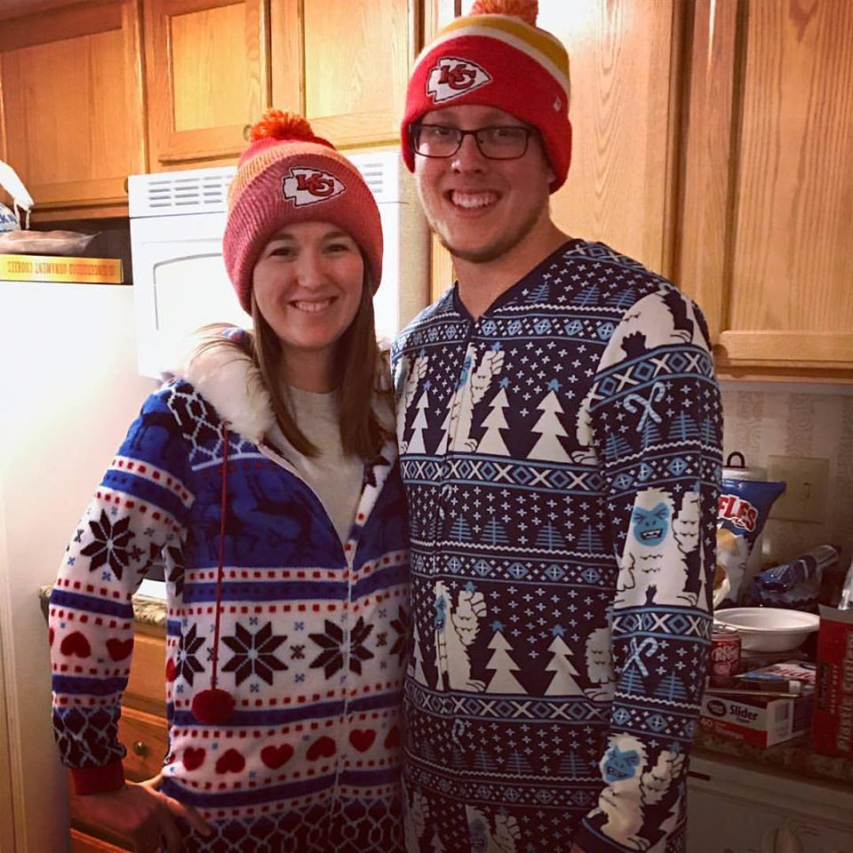
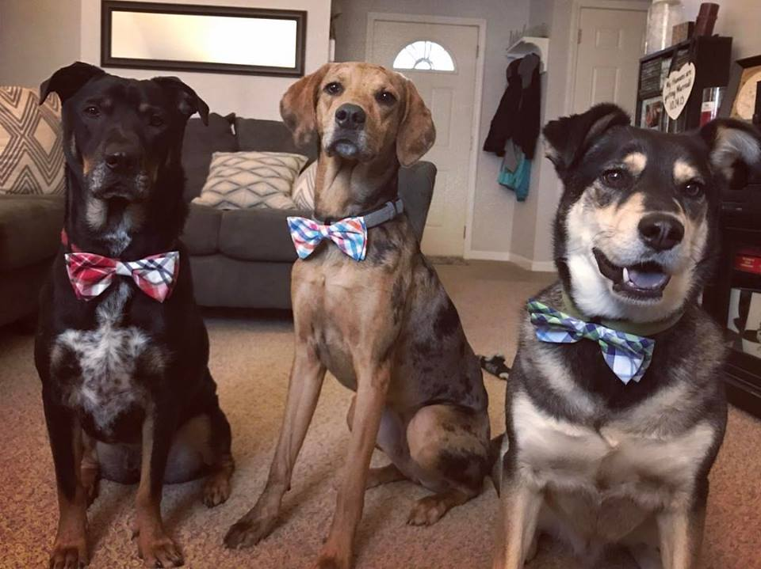
WHO AM I?
Notes:
I am a person who is passionate about writing, but if you ask me to draw something I will look at you with panic. I took a couple of art classes to really tune in my stick figures, but to no avail. ‘Twas when I took my art class that taught Calligraphy. I knew that my cursive was better than my print, but I had no idea that I could write with a Calligraphy pen. To me, Calligraphy was art, but in order to write words with these magical pens, I would need words to write. That’s when my passion for writing began.

Slide 3
GOAL
Develop a life lesson.
Write a tribute
Reflect on this writing.
Notes:
Turn a kernel essay into a piece about a life lesson, finding your own angle to the prompt.
Be able to reflect on this lesson and see that this essay could be in a variety of formats, such as letters, essay, memoirs.

Slide 4
HOW WE WILL LEARN
Break the ice
Kernel essay.
Thick description.
Pair Share

Slide 5
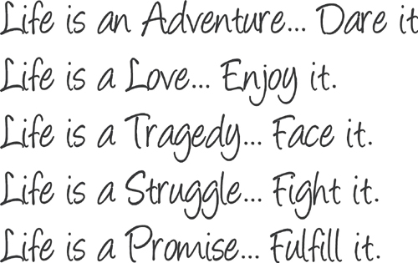
WHO IS IN THE “ART”MOSPHERE?
Who means the most to you? Why?
Turn and Talk
Notes:
Sharpie and Pencil

Slide 6
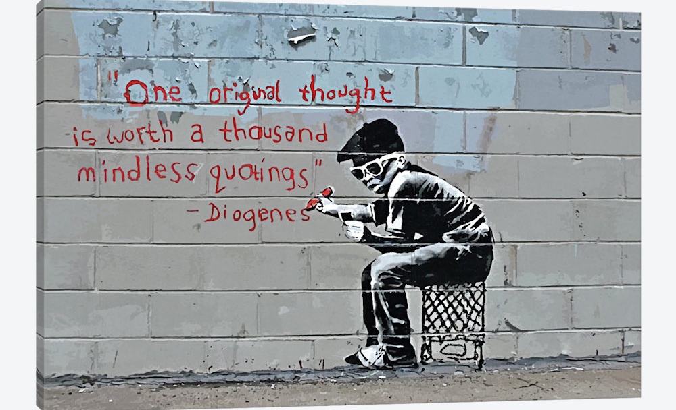
What is an important life lesson you’ve learned?
Writing is one of the most expressive art forms

Slide 7
What the lesson is
Flashback to the lesson
Description of the person
Lyrics or words you can remember that person saying (on any subject)
What I wish I could find out now from that person

Slide 8
What the lesson is | Never be afraid to express yourself.
Flashback to the lesson
Description of the person
Lyrics or words you can remember that person saying (on any subject)
What I wish I could find out now from that person

Slide 9
What the lesson is | Never be afraid to express yourself.
Flashback to the lesson | I was standing in my house after the phone call that my grandfather had passed. My first thought, “I wasn’t able to tell him goodbye.”
Description of the person
Lyrics or words you can remember that person saying (on any subject)
What I wish I could find out now from that person

Slide 10
What the lesson is | Never be afraid to express yourself.
Flashback to the lesson | I was standing in my house after the phone call that my grandfather had passed. My first thought, “I wasn’t able to tell him goodbye.”
Description of the person | He was a calm, joyful spirit. Always the most caring. He would never turn anyone down for help. He would also say a lot on his mind
Lyrics or words you can remember that person saying (on any subject)
What I wish I could find out now from that person

Slide 11
What the lesson is | Never be afraid to express yourself.
Flashback to the lesson | I was standing in my house after the phone call that my grandfather had passed. My first thought, “I wasn’t able to tell him goodbye.”
Description of the person | He was a calm, joyful spirit. Always the most caring. He would never turn anyone down for help. He would also say a lot on his mind
Lyrics or words you can remember that person saying (on any subject) | As we would jump in the lake, he would always say, “Don’t get wet.”
What I wish I could find out now from that person

Slide 12
What the lesson is | Never be afraid to express yourself.
Flashback to the lesson | I was standing in my house after the phone call that my grandfather had passed. My first thought, “I wasn’t able to tell him goodbye.”
Description of the person | He was a calm, joyful spirit. Always the most caring. He would never turn anyone down for help. He would also say a lot on his mind
Lyrics or words you can remember that person saying (on any subject) | As we would jump in the lake, he would always say, “Don’t get wet.”
What I wish I could find out now from that person | What is it like to pass? How do I cope with death?

Slide 13
My Example
Throughout the years, I would always go to my grandma and grandpa's house and spend what seemed to be like weeks there. But it would never feel that way. Time always seemed to fly by because I would have the best times of my life there. They used to live on the lake in Kansas. Grandpa wouldn't ever be dressed up, unless it was Sunday. Other than that, he usually wore a pair of khaki shorts, a polo, and a bucket hat (color depending on his mood). He would always be laughing. And his laughing was contagious, BUT, his jokes were just awful. They weren't usually dirty, or anything of a comedian. They were just bad jokes. I grew to cherish those jokes and eventually say them myself. We would always laugh together and try to best each other on the joking, but I would usually be the one getting bested.
He was a good man. Not being biased either. He never had a frown on his face, nor have I seen him hateful or nasty towards anyone. He was always the life of the party and would try to make everyone as happy as possible. Most of the time it worked. I don't think I've ever seen anyone not laugh at his jests. Except for Grandma.. But she gave in eventually.

Slide 14
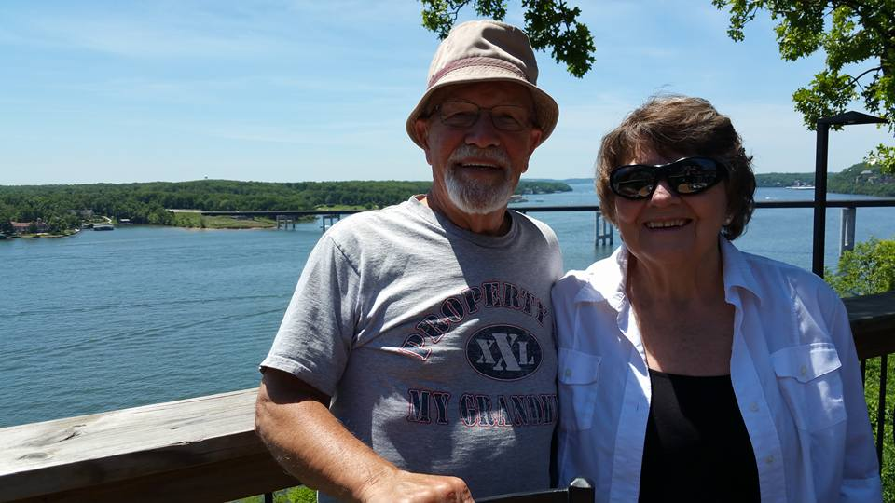
Thick Description: Add an Object
He would always wear these hats when he wasn’t working or going to church.
This was his “vacation” hat. Or his hat when he was relaxing.

Slide 15
Thick Description: What is an object that reminds you of your person?

Slide 16
Where’s The Beef?
What did your BRAIN think?
What did your EAR hear?
What did your EYE see?
Where did your FEET go?

Slide 17
PAIR SHARE

Slide 18
Closure (Reflection)
Look over your tribute
Are there things you would like to revise?
Do you think you could incorporate something like this with your writing? Be it creative, or maybe another tribute?

