Slide 1
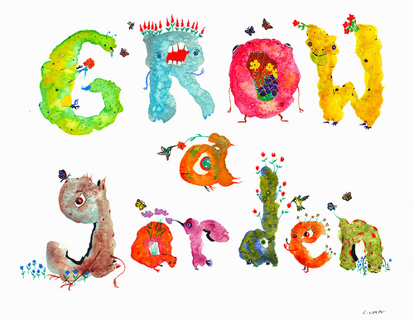
The Insight Garden
Presented by Megan Rogers
Ozarks Writing Project
December 8, 2017

Slide 2
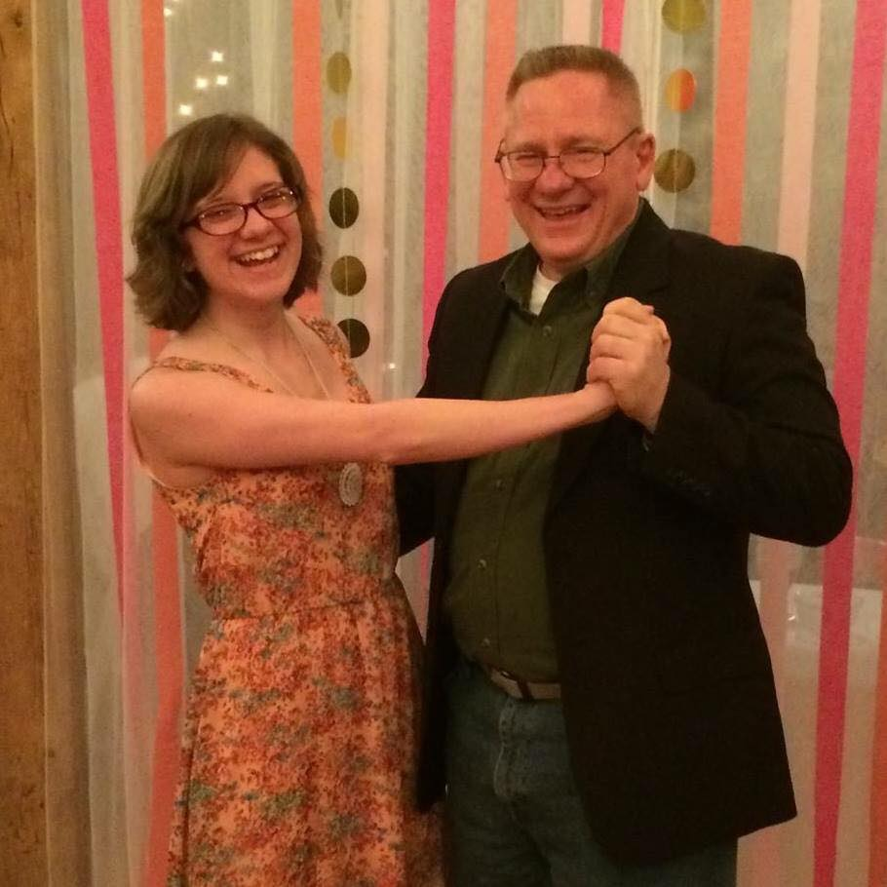
Salutations!
My name is Megan Rogers and I am an English Education major with a minor in Creative Writing

Slide 3
Getting to Know You!
Please rise a hand and search the room for another student that you do not know who also has their hand up. Give them a high-five and answer these questions:
Name?
What school do you attend?
When you were a kid, what did you want to be when you grew up?
Or
If you had an endless supply of any food, what would you get?

Slide 4
Goals and Objectives
Students will be able to write on the inspirations they have gathered from observing everyday items
Students will be able to discover writing preferences through their own interpretations

Slide 5
Agenda
Just What is an Insight Garden?
Gather Insight from Articles
Writing Time
Pair Share
Closure

Slide 6
Just What is an Insight Garden?
The purpose of this exercise is to find inspiration from everyday and ordinary items
By gathering and examining these items, we hope you can create something truly unique!

Slide 7
Gathering Insight from Articles
We’ll start with that station you are seated at.
What items immediately grab your attention?
Write your thoughts, feelings, senses, and observations about these items!
Do this until you hear the timer sound. This means it’s time
for you to rotate to the next table.

Slide 8
Let the Garden Grow!
We will continue to rotate tables for 15 minutes
While rotating and observing, keep these questions in mind:
How do this items connect with your own life experiences or with someone else’s life experiences?
Or how can you connect these items to a fictional piece you enjoy?
How can you view these items in a new light?
This Photo by Unknown Author is licensed under CC BY-SA

Slide 9
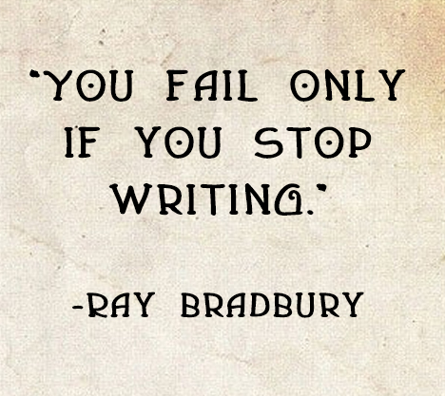
Time to write!

Slide 10
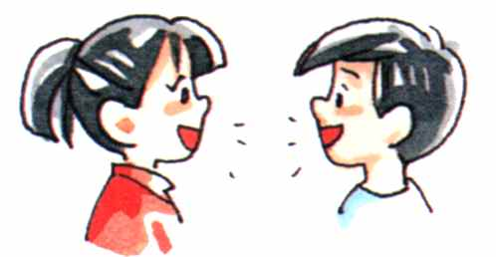
Pair Share
Rise your hand again and find a new high five partner.
This time, share a small piece of your writing with them. A sentence or two or even a word that amuses you. Share what is comfortable for you!
We will do this for 10 minutes.
Partners may share feedback if they wish
Be respectful! Thank your partner for sharing!

Slide 11
Closure
For the remaining 5 minutes, consider these
questions:
Are you proud of your writing?
Can you expand this piece if you wanted to?
What did you learn from this Insight Garden Experience?

