Slide 1
The Insight Garden: Growing Opinions from Art, Literature, and Life
A Timed, Guided Writing
Ms. Koppelmann

Slide 2
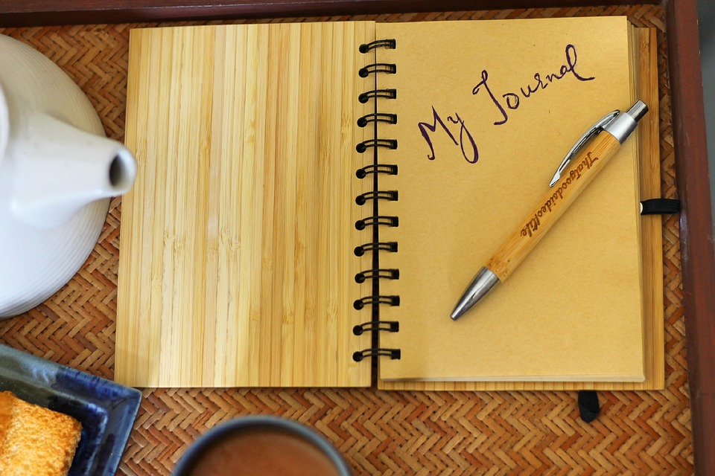
What Writing Means to Me
Notes:
Tell story about elementary journal.
3 min.

Slide 3
Get to know you
Find a partner that you do not know and ask them what school they are from and why they enjoy writing
Notes:
3 min

Slide 4
Goals and Objectives
Students will…
Use truisms provided or create their own truisms to compose a writing piece from memory provoking artifacts

Slide 5
Agenda
Rotate writing stations
Expand
Share with a partner
Share with the class if you choose
Notes:
Rotate to each station and write to the prompts.
Come back together and expand on one or more artifacts and truism of your choice.

Slide 6
Truism
A truism is a statement that is obviously true and says nothing new or interesting
The apple never falls far from the tree

Slide 7
Station Rotation
Notes:
Use one minute to explain the statement.
What does it mean? What is your interpretation of it?
For the next three minutes, tell how it’s true in a piece of literature, a story.
For the next three minutes, tell how it’s true in a movie you’ve seen.
For the next three minutes, tell how it connects to your life, our world.
In the next minute, finish with something your discussion leaves you wondering about the statement.
Should be set up to have 3 stations with one artifact.

Slide 8
Expand
Notes:
You can take your write in any direction. If you decide to use another truism you may.
You might write about a memory or you might write a fiction piece.
There are no boundaries.

Slide 9
Share Your Work
Notes:
Find a new partner and share a piece of what you wrote.
Did you enjoy this activity?
Did you find certain parts difficult?
2 minutes each

Slide 10
Group share

