Slide 1
Evolution of My thinking
Presented by Madeline Carasco

Slide 2
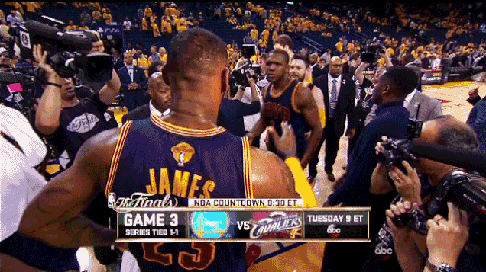
introduction
Notes:
Allow students to complete an ice breaker exercise: time, as needed. Not to exceed 5 minutes.
Ice Breaker: Find someone you do not know
Name
School
What you like about writing

Slide 3
Today’s Objectives
What is a truism?
Focused Freewrite.
Discover meaning of a word or phrase.
Kernel Essay.
Expand our thinking.
Share! Share! Share!
Notes:
Discuss the expectations of the lesson:
How their thought process evolves—through writing, also through writing about their experiences---

Slide 4
Truism
A truism is a statement that is so widely accepted, or so evident and factual, that questioning its validity is considered foolish. A truism does not need to be supported by any other evidence. It is accepted as "true."
Notes:
Explain the basic premise of what a truism is to the students.

Slide 5
Focused FreeWRite
Notes:
Students will have 10 minutes to complete a focused freewrite based on the truism examples on slide 6.

Slide 6
Truism Examples
Hope is the only thing stronger than fear.
What goes around come around.
Actions speak louder than words.
A journey of a thousand miles begins with a single step.
Everything happens for a reason.
Notes:
Read truism examples aloud to class.
Ask students to pick a truism, may be one of their own, and write it on the top of a piece of paper.
Give the students 10 mintues to write about their thinking- true/untrue, feel, think, memories, experiences, and so on.

Slide 7
Pick a Word
Kernel Essay Handout
Notes:
Have students read through free writes. Circle/highlight a word or phrase.
Pick a word you are willing to share with the class.
Ask for 2 student volunteers to write words on the board. Ask all students to share their word, and they will be written on the board.
Once this is finished, pass out the kernel essay handout. Students can use their original word or a new word, and fill out the handout accordingly.
15-20 minutes.

Slide 8
Kernel Essay Expanded
How or Why did the word or phrase evolve?
Notes:
On a separate sheet of paper, students should think critically about the evolution of their word or phrase. Ask students to expand on their kernel essays, and answer how or why their thinking has evolved?
May use one box of the kernel essay handout, or the entire handout– however the student wishes to complete the question.
Allow students to write until about 5 minutes of class is left.

Slide 9
Share! Share! Share!
Thank you.
Notes:
In the final 5 or so minutes, ask students to pair with a partner and share a piece of their writing.
Ask for any volunteers to share with the whole class, and discuss how this process assisted their writing experience.

