Slide 1
Tribute to the Person Who Taught Me Something
HSWC 2017
Notes:
On this slide I will briefly welcome everyone
introduce myself,
my passion for writing,
calculating in time for students to sit,
5 min mark

Slide 2
The King of Taney
His boots had dirt on them,
the day they slid them off,
the noble King of Taney.
His jeans were high,
his pearl snaps clean
The day they took him in…
Notes:
On this slide I will discuss my own background in writing Tributes, I will also tell the story of writing this Tribute to Bobby George Rains
7 minute mark

Slide 3
Goal
Turn a kernel essay into a piece about a life lesson, finding your own angle to the prompt
Notes:
I will be explaining that we will not be writing a complete essay, but rather the pieces to a whole essay.
The hope is not to finish but to have writing that we want to return to and finish.
We will also be learning a strategy for writing Tribute by which we can continue to write tributes in the future.
11 min mark

Slide 4
How We Will Learn
Break the ice with a turn and talk.
Write a kernel essay.
Experiment with thick description.
Share.
Notes:
I will explain the plan for the next 45 min,
We will…
Break the Ice with Turn and Talk
Write a Kernal Essay,
Experiment with thick description
Share
13 min mark

Slide 5
Who’s in the room?
Who taught you an important life lesson? What was the lesson?
Turn and talk.
Notes:
Students are given five minutes to discuss with a partner, 18 min mark

Slide 6
Do what you love.
Follow your passions
Procrastination is stolen time.
Notes:
Students will be asked to write that lesson as a “Truthism” with alternates as well. Two minutes, 18 minute mark.

Slide 7
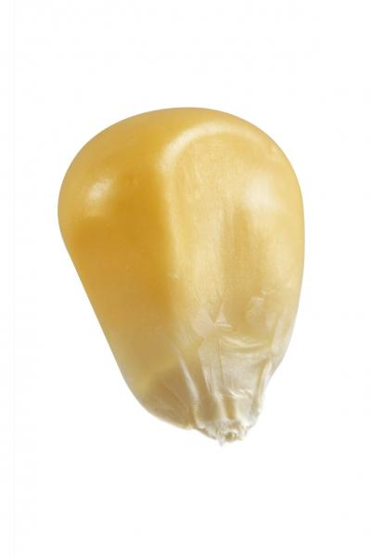
What the lesson is
Flashback to the lesson
Description of the person
Lyrics or words you can remember that person saying (on any subject)
What I wish I could find out now from that person
Notes:
We have done the first part, we will then write each of the following with 3 minutes each - 20 minute mark
Flashback- Write a memory, describe all features in detail. 23 minute mark
Description of Person- Describe what they are like or were like. 26 minute mark
Lyrics or Words- 29 minute mark
What I wish I could find out now- 32 minute mark

Slide 8
What the lesson is | Do what you love.
Flashback to the lesson | I would talk with Bob at his grandkids basketball games, or on his land.
Description of the person | He was a rough looking old man, grouchy but kind.
Lyrics or words you can remember that person saying (on any subject) | ”Hey Preacher Man!”
What I wish I could find out now from that person | Did he have any regrets.
Notes:
Share my own answers- 2 min- 34 minute mark

Slide 9
Thick description: add an object
Pearl Snap Shirt
Cowboy Boots
Big belt buckle
Notes:
A Thick description is going into detail about an object associated with the person. 5 minutes. 39 minute mark
Student are then asked to produce a piece of writing, maybe a poem, an essay, something using their previous writing as their resource. They will be given 10 minutes to write. 50 minute mark

Slide 10
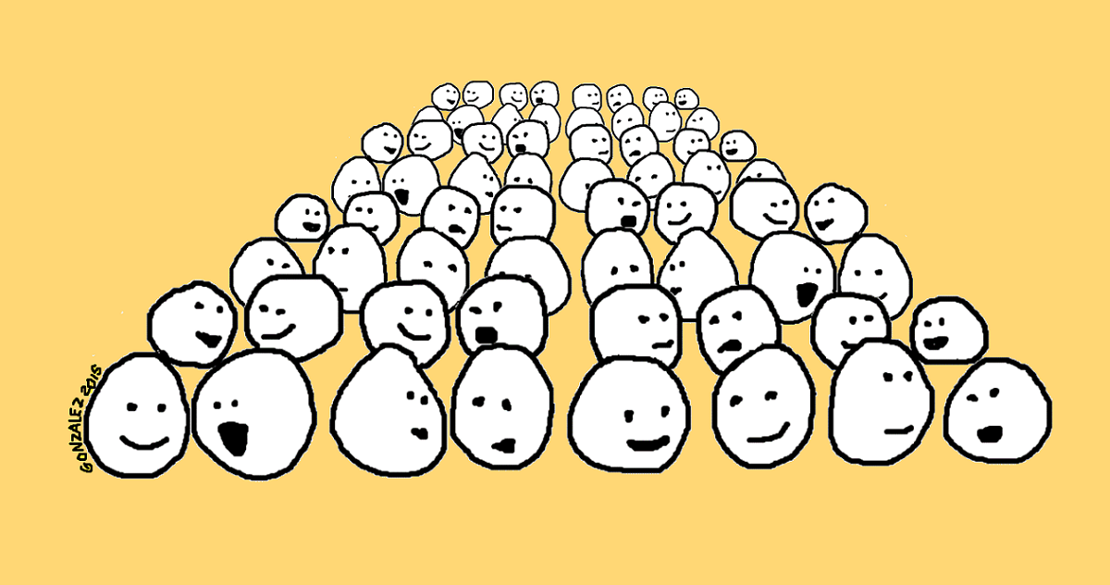
Pair Share
Notes:
Find the same partner that you shared question flood with. Share part or all of your piece.
The students will be given eight minutes to share with a partner what they have written. 58 minute mark

Slide 11
Where's the BEEF?
What did your BRAIN think?
What did your EAR hear?
What did your EYE see?
Where did your FEET go?
Notes:
An extra Slide in case there is extra time

Slide 12
Goal
Turn a kernel essay into a piece about a life lesson, finding your own angle to the prompt
Notes:
The original goal repeated, and students are encouraged to complete and share their tributes once home, and to continue the practice. 2 minutes 60 minute mark.

Slide 13
Question Flood
Notes:
From Kelly Gallagher. Model this for students. Students find a partner (Stand up, hand up, pair up) and conduct a sentence flood.
Take an underwritten piece of writing, such as the paragraph above, and place it on an overhead.
Read the paragraph out loud so that students get the gist of it.
Give them some “think time.”
Read the paragraph out loud a second time. This time, as you read it, have students call out any questions they have.
Mark those questions on the text (paragraph).
Once that is done, do a “think aloud” with the students to show them which questions you intend to answer and how you intend to answer them.
Model revising the paragraph in front of them.
Once students understand the technique, have them get into small groups (2-5 students per group) to exchange their own papers.
Have the students perform the “question flood” technique and revise their papers.
Write for 15 minutes.

Slide 14
Debriefing Protocol
2 minutes for clarifying questions
3 minutes for probing questions
8 minutes for audience to discuss; presenter takes notes
4 minutes for presenter to respond
3 minutes for final questions and comments
Notes:
20 minute protocol

