Slide 1
Leadership Writing with Online Media
High School Writing Conference 2017

Slide 2
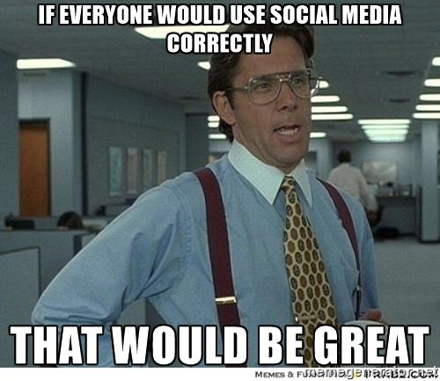

Slide 3
Audra Vanhooser
Bolivar High School
English I & II

Slide 4
Agenda
Introductions
What is a Leader?
Social media relevance
Building Your Online Presence as a Leader
Tips and Practice

Slide 5
Islands Ice-Breaker
Get into groups of 3-4
Introduce yourself to each other
Round 1- Birthdays: Youngest goes to another island
Round 2- Siblings: Person with the most goes to another island
Round 3- Pets: Person with most pets goes to another island

Slide 6
Leadership
https://www.youtube.com/watch?v=fW8amMCVAJQ

Slide 7
Elements of a Good Leader
What does it mean to be a leader?

Slide 8
It’s 2017...social media matters
Social media is here to stay for the foreseeable future; we need to learn to use it to our advantage.
Free write: What are your thoughts about social media? What do you like or dislike about it?

Slide 9
http://bit.ly/2BVSz50

Slide 10
First things first: Be Nice
http://resources.uknowkids.com/blog/the-phenomenon-of-cyberbullying-are-we-paying-enough-attention
http://cyberbullying.org/2016-cyberbullying-data
https://www.theverge.com/2016/7/19/12232738/twitter-bans-milo-yiannopoulos

Slide 11
How do you handle trolls?
You are so ugly.
This is the stupidest thing I’ve ever heard of.
How do you even get out of bed every day?

Slide 12
Writing With a Purpose: What do you believe in?
In your notebooks, list the top five things you care about.
Are these things you like to represent/defend/talk about online?

Slide 13
Building Your Online Presence
https://www.forbes.com/sites/danmatthews/2014/06/06/how-effective-people-use-social-media/#4956c2ac6a40
“People who use social media efficiently, and there aren’t many of them, are those who can bypass the urge to use it as a device to gauge where they stand in the world.”

Slide 14
Kardashian or Watson?
Be like Emma, not Kim…

Slide 15
Be consistent!
Successful YouTubers stick to a schedule: new videos every Monday, Wednesday, and Friday.
If you want to build a following online, decide how often you want to post.
Posting multiple times a day may distract from your own content.

Slide 16
Post at Peak Times

Slide 17
Practice
How would you promote a fundraiser to buy baby turtles diapers?
Write a tweet.
Write a Facebook post.
Generate an image and post for Instagram.
How would you handle an angry comment?

Slide 18
How will you be a leader?
Go back to your list of priorities from earlier.
Are these things you would like to write about?
Use the time we have left to plan how you want to build your online presence.
What will you write about?
What kinds of images will you post?
Will you use websites like Canva to enhance your media?
What sites will you focus on?
Will you start a blog?

Slide 19
Canva.com
What will you write about?
What kinds of images will you post?
Will you use websites like Canva to enhance your media?
What sites will you focus on?
Will you start a blog?

