Slide 1
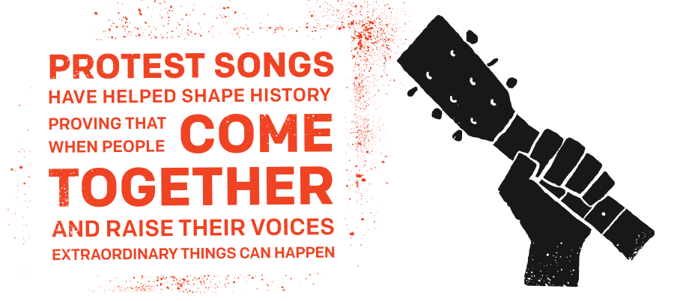
Justice League: Writing to Save Your World
By: Kara Holland, Jessie Smallwood, and Sophia Gutierrez

Slide 2
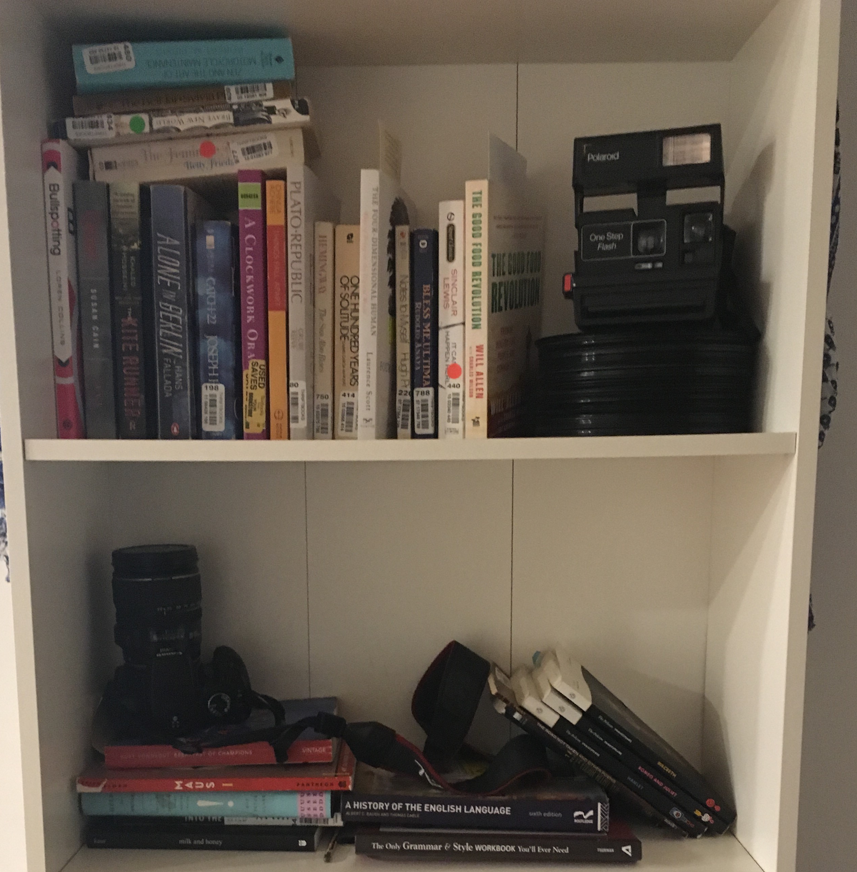
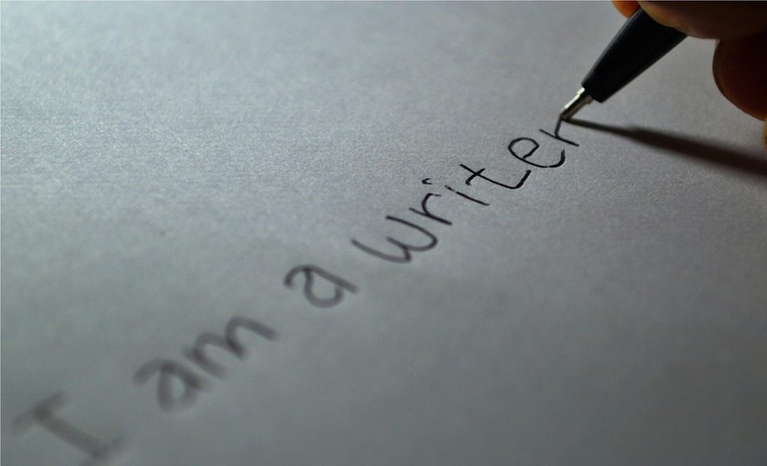
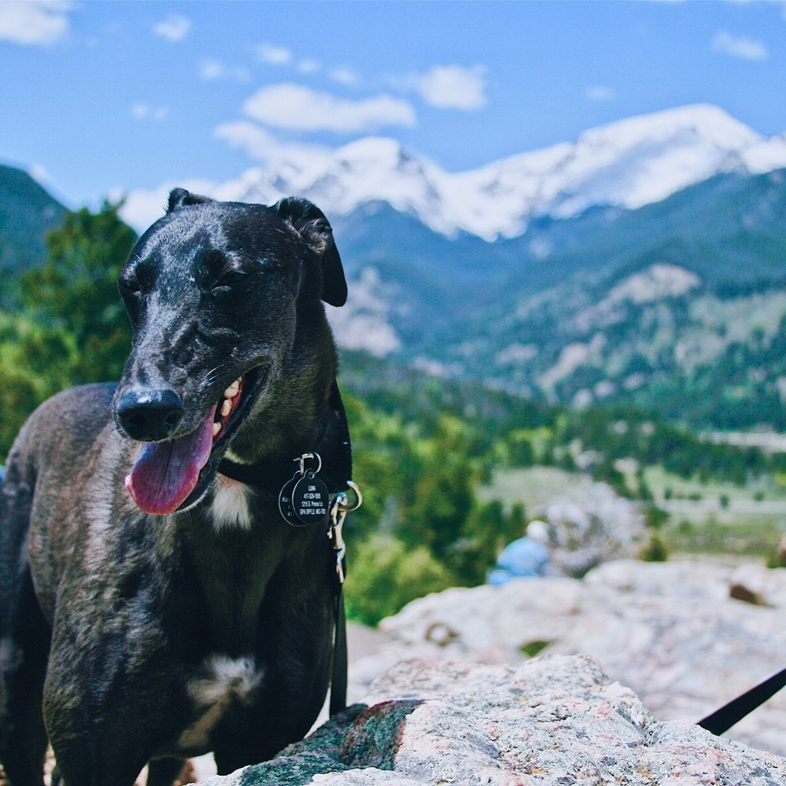
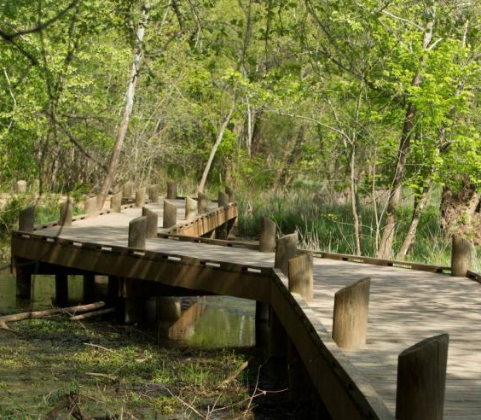
Kara Holland

Slide 3
Purpose
To weave together songs of protest with narrative writings.
To find your own voice and effectively state your opinions through social justice writing.

Slide 4
Non Purpose
To examine social justice poems and lyrics.

Slide 5
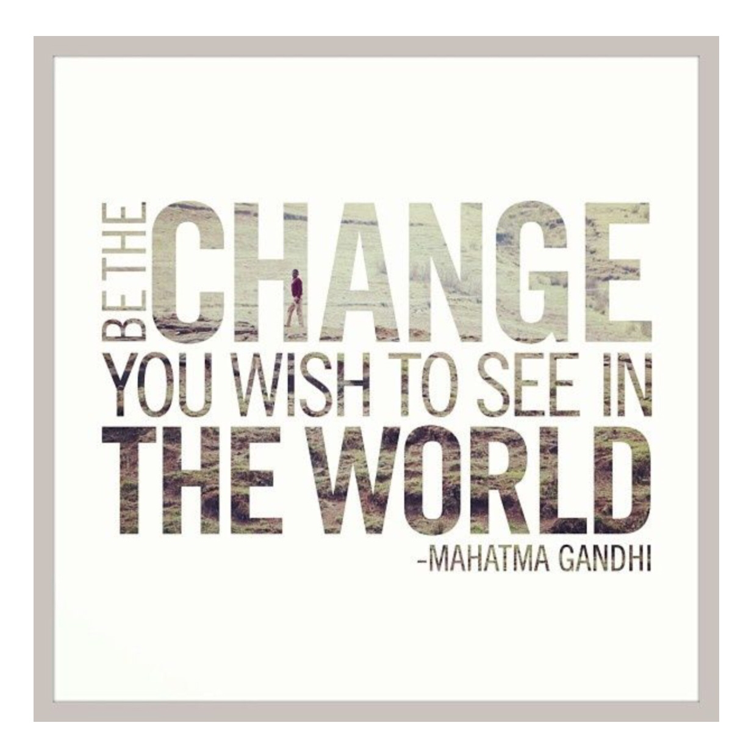
Agenda
Identify current social justice issues.
Write about an issue that concerns you.
Weave a protest song into your writing.
Share the new product with a partner or the class.

Slide 6
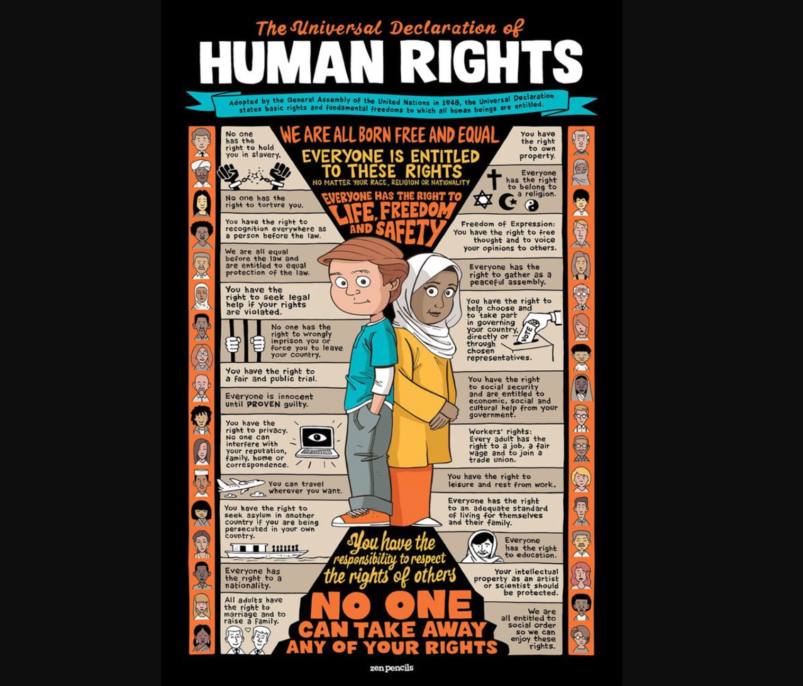
The Universal Declaration of Human Rights Adopted by the United Nations in December of 1948 in Paris, France.

Slide 7
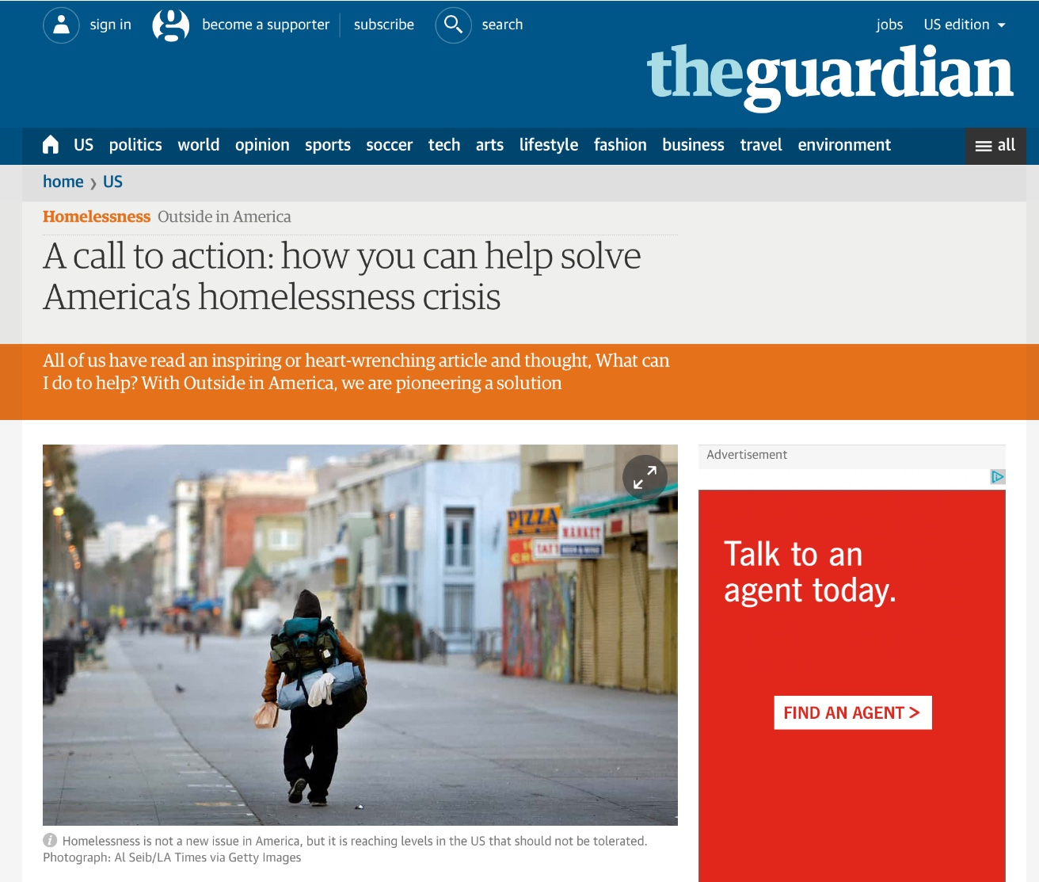
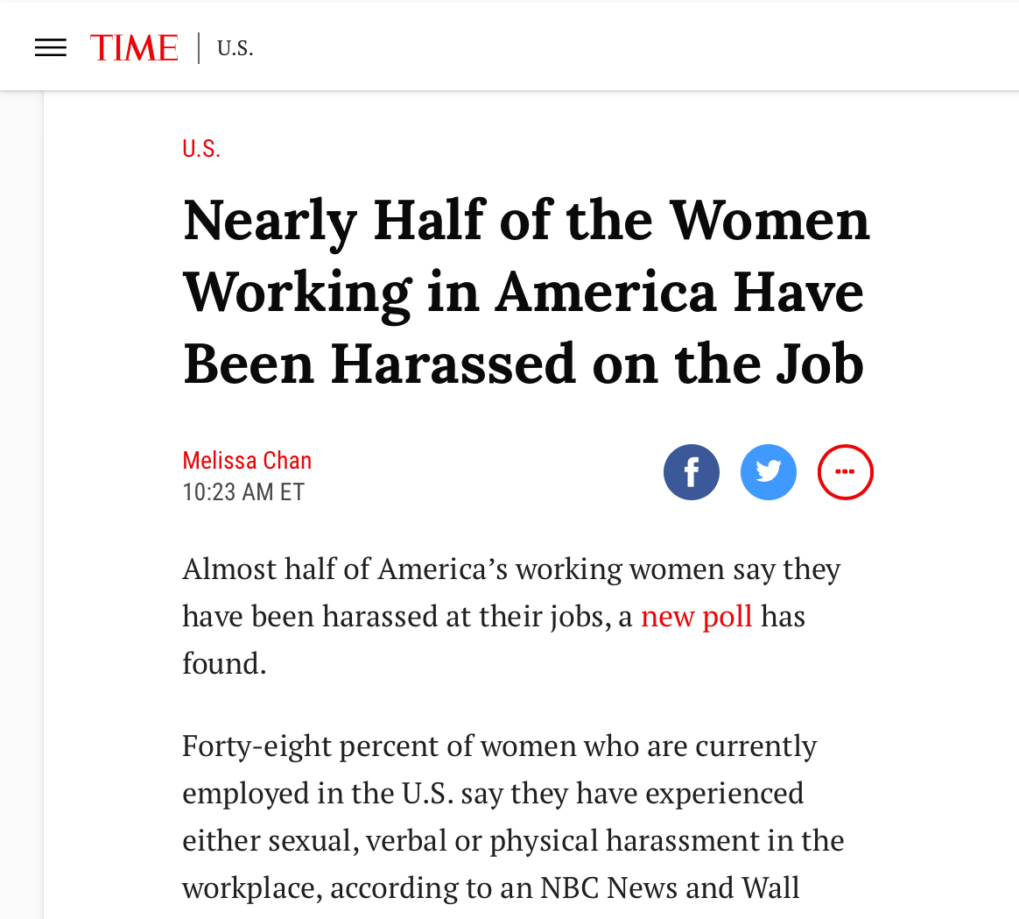
Headlines
Can
You
Find
Any
More
?
“A call to action: how you can help solve America’s homelessness crisis”
Nearly Half of the Women Working in America Have Been Harassed on the Job

Slide 8
Discuss
What are social justice issues that concern you? Discuss with a partner.

Slide 9
The thing you are most afraid to write.
Write that.
Nayyirah Waheed

Slide 10
Write
Choose one of the topics that you would like to see changed in our society.
How does this topic make you feel?
How can you help make a difference?

Slide 11
Now underline at least four sentences from your writing that you're most proud of and share at least one of those lines with a partner.
After you listen, only reply with,
“Thank you for sharing”.

Slide 12
Social Justice Poem

Slide 13
Weave
Choose a song from the handouts.
Take the underlined sentences from your first writing and combine them with lines from the song.

Slide 14
Adoption by Jeddie Bristow
Oh brother, I will hear you call!
500,000 children in foster care, in need of homes
To call their own
What if I lose it all?
Only about 10% of foster children enter college
Only 3% graduate
Oh sister, I will help you hang on
If one family out of every three churches in America
Adopts a child out of foster care
There will be no more children waiting for homes
What if I'm far from home?
Pro-life should mean PRO-ADOPTION
There's nothing in this world I wouldn't do
Adoption and fostering isn't easy
But Jesus never said life would be easy
Do you still believe in love?
My mom always told me
The ones that are hardest to love are the ones
Who need it most

Slide 15
Share your work with: A partner A small group The class

Slide 16
Closing
What did you learn?
What will you do now with the information you have learned?

Slide 17
Sources
Image one
Image two
Image three
Universal Human Rights Graphic
Pencil Lightbulb image
Find your voice graphic
Adoption

Slide 18
Freedom
Beyoncé (feat. Kendrick Lamar)
[Beyoncé:]
Tryna reign, tryna rain on the thunder
Tell the storm I'm new
I'ma walk, I'ma march on the regular
Painting white flags blue
Love forgive me, I've been running
Running blind in truth
I'ma rain, I'ma reign on this bitter love
Tell the sweet I'm new
I'm telling these tears, "Gonna fall away, fall away"
May the last one burn into flames
Freedom! Freedom! I can't move
Freedom, cut me loose!
Freedom! Freedom! Where are you?
Cause I need freedom too!
I break chains all by myself
Won't let my freedom rot in hell
Hey! I'ma keep running
Cause a winner don't quit on themselves
I'ma wade, I'ma wave through the waters
Til the tide, "Don't move"
I'ma riot, I'ma riot through your borders
Call me bullet proof
Love forgive me, I've been runnin'
Runnin' blind in truth
I'ma wade, I'ma wave through your shallow love
Tell the deep I'm new
[Kendrick Lamar:]
What you want from me?
Is it true you see, uh? Oh father can you hear me?
What you want from me?
Is it true you see, uh? Oh father can you hear me?
Hear me?
[Hattie White:]
I had my ups and downs, but I always find the inner strength to pull myself up. I was served lemons, but I made lemonade
Man in the Mirror
Michael Jackson
I’m gonna make a change, for once in my life
It’s gonna feel real good, gonna make a difference
Gonna make it right...
As I turn up the collar on my favorite winter coat
This wind is blowin’ my mind
I see the kids in the street, with not enough to eat
Who am I, to be blind? Pretending not to see their needs
A summer’s disregard, a broken bottle top
And a one man’s soul
They follow each other on the wind ya’ know
’Cause they got nowhere to go
That’s why I want you to know
I’m starting with the man in the mirror
I’m asking him to change his ways
And no message could have been any clearer
If you wanna make the world a better place
(If you wanna make the world a better place)
Take a look at yourself, and then make a change
(Take a look at yourself, and then make a change)
(Na na na, na na na, na na, na nah)
I’ve been a victim of a selfish kind of love
It’s time that I realize
That there are some with no home, not a nickel
to loan
Could it be really me, pretending that they’re
not alone?
A willow deeply scarred, somebody’s broken heart
And a washed-out dream
They follow the pattern on the wind, ya’ see
’Cause they got no place to be
That’s why I’m starting with me
Starting with me!
Oh Brother
Avicci
Hey brother! There's an endless road to rediscover
Hey sister! Know the water's sweet but blood is thicker
Oh, if the sky comes falling down, for you
There's nothing in this world I wouldn't do
Hey brother! Do you still believe in one another?
Hey sister! Do you still believe in love? I wonder
Oh, if the sky comes falling down, for you
There's nothing in this world I wouldn't do
What if I'm far from home?
Oh brother, I will hear you call!
What if I lose it all?
Oh sister, I will help you hang on!
Oh, if the sky comes falling down, for you
There's nothing in this world I wouldn't do
Hey brother! There's an endless road to rediscover
Hey sister! Do you still believe in love? I wonder
Oh, if the sky comes falling down, for you
There's nothing in this world I wouldn't do
What if I'm far from home?
Oh brother, I will hear you call!
What if I lose it all?
Oh sister, I will help you hang on!
Oh, if the sky comes falling down, for you
There's nothing in this world I wouldn't do
Glory
John Legend
Hands to the Heavens, no man, no weapon
Formed against, yes glory is destined
Every day women and men become legends
Sins that go against our skin become blessings
The movement is a rhythm to us
Freedom is like religion to us
Justice is juxtapositionin' us
Justice for all just ain't specific enough
One son died, his spirit is revisitin' us
Truant livin' livin' in us, resistance is us
That's why Rosa sat on the bus
That's why we walk through Ferguson with our hands up
When it go down we woman and man up
They say, "Stay down", and we stand up
Shots, we on the ground, the camera panned up
King pointed to the mountain top and we ran up
One day when the glory comes
It will be ours, it will be ours
Oh one day when the war is won
We will be sure, we will be sure
Oh glory (Glory, glory)
Oh (Glory, glory)
Now the war is not over, victory isn't won
And we'll fight on to the finish, then when it's all done

