Slide 1
Insight Garden
HSWC 2017
Presented by Maddi Heberling

Slide 2
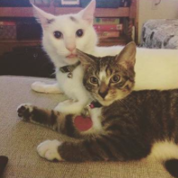
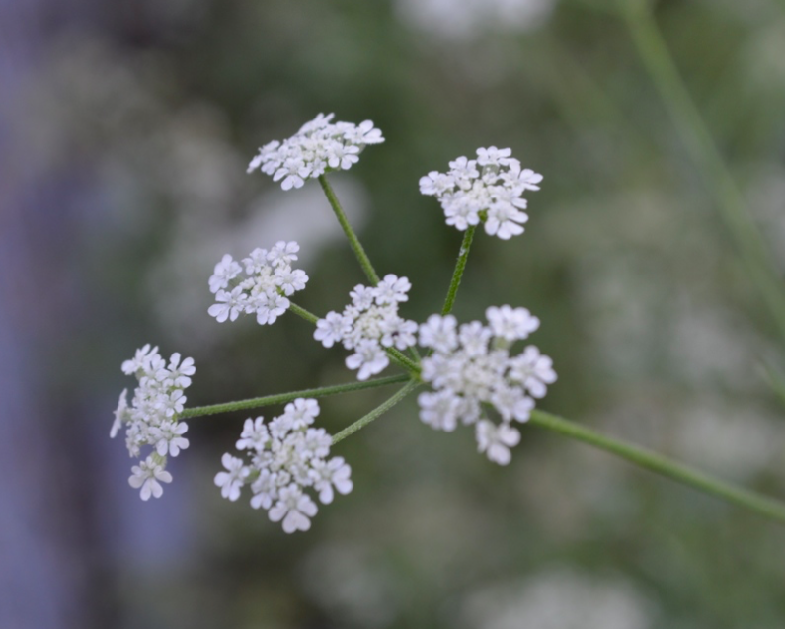
Introduction - Why I write
“The more that you read, the more things you will know. The more that you learn, the more places you’ll go.”
– Dr. Seuss

Slide 3
Thaw your garden, break the ice - Why do you write?
When did you start to write?
Where do you like to write?
What hobbies other than writing do you enjoy?

Slide 4
Goals
INSIGHT
WRITE
SHARE
REFLECT
☺

Slide 5
Overview
15 minutes of insightful “gardening”
20 minutes of writing
7 minutes of pair-sharing
7 minutes of large group sharing
5 minutes reflection

Slide 6
Examine the Artifacts, Grow Your Garden
Write about the artifact in front of you first until timer runs out.
Move seats to the left, write about the next artifact (or trade it out).
Describe, infer, connect, remember... do everything you can to keep your pencil moving!
Goal: 6-7 artifacts examined

Slide 7
Pick your favorite, write your roots
Look through your notes and pick your favorite artifact you examined.
Try to combine your notes with a memory, thought, or idea. You might create a setting, character, poem, letter, short story, song, fan fiction, memoir, etc.
Some questions you might like to answer:
What pieces of literature does this object remind you of?
What movies does this remind you of?
What memory does this remind you of?
What does it make you wonder about? What questions are you asking?

Slide 8
Pair Share
Find a partner
Share some of your writing with your partner. This can be all of your writing, or just one word. Use appreciative listening and just say “thank you.” ☺

Slide 9
Group Share
Let’s come back together as a big group.
Volunteers?

Slide 10
Closure
What did you learn, about yourself or your writing?
What are your next steps for this piece? If you had more time, what would you do? Which part would you explore more?

