Slide 1
”Let One Go” Parody – the most fun type of writing
Miss Amy Sampson
Monett High School
YWC 2017
Notes:
Change the presentation layout any way you like, but please include these basic elements and the CWCCC logo.

Slide 2
Introduce Yourself
How might I share my career path as a writer and my passion for writing?

Slide 3
Goals/Objectives/Outcomes
Notes:
Examples of goals

Slide 4
Agenda
Notes:
Examples of goals

Slide 7
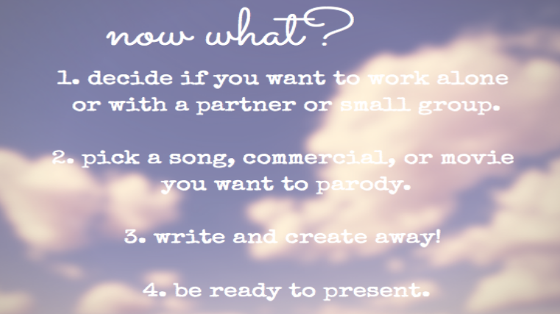

Slide 8
