Slide 1
Fanfiction
YWC 2017
Notes:
Change the presentation layout any way you like, but please include these basic elements and the CWCCC logo.

Slide 2
Sofie Kondro
What my student’s think I write...
What my mom thinks I write...
What my husband knows I write...
What I think I write...
What I really write...
Writer.
Teacher.
Coach.
Geek.

Slide 3
Goals/Objectives/Outcomes
Discover why people read and write fanfiction.
Create fanfiction from prompts.
Connect fanfiction to our lives.
Notes:
Examples of goals

Slide 4
Agenda
Why do we read/write it?
What is fanfiction? How popular is it?
What can fanfiction do to help us be better writers? (3 specific things)
Notes:
Examples of goals

Slide 5
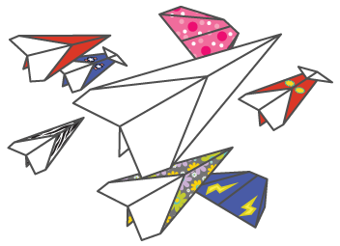
Paper Airplane Game
Notes:
Directions: Students will write their name and 3 things about themselves they want to share and then make a paper airplane. On the count of three, all students will throw their paper airplane. Then, the students will find each other (based on names) and talk about what they wrote on their paper airplanes.

Slide 6
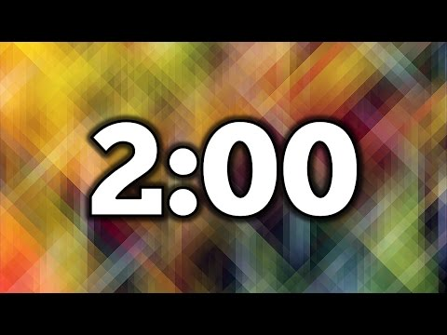
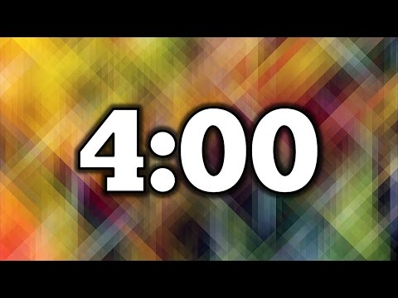
Why Do We Write?
Think | Pair | Share
For 2 minutes, write about why you read and write. | Share with a partner what you wrote. | As a large group, let’s discuss what we talked about in small groups:
Notes:
I’m using a simple think.pair.share. Activity to get kids to think about why we write and why we read.

Slide 7
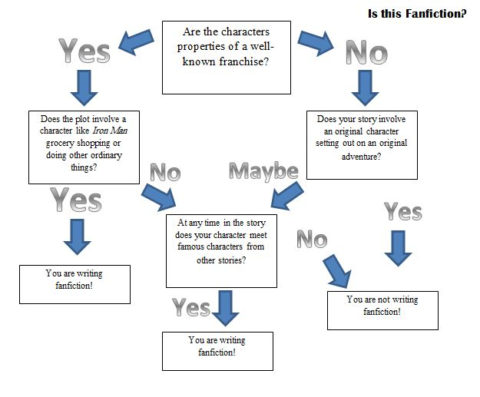

Slide 8
What is Fanfiction?
Fanfiction is any creative piece of writing/art that:
Uses already established characters or settings from a franchise or existing creative property. (example: A story about Iron Man grocery shopping)
Has an original character but the original character lives in an already established world. (example: Mary Sue goes to Hogwarts)
A piece of art, music, etc that pays homage to a character or story.

Slide 9
An Example of Fanfiction
Just a Hufflepuff by Oliver Boyd and the Remembralls

Slide 10
3 Ways Fanfiction Helps Us Develop Stronger
Writing Skills
Allows us to “play in a developed world.”
Allows us to “use someone else’s ideas” but in our own way.
Allows us to practice.
Notes:
1.Sometimes world building is challenging to new writers. Trying to dream up new lands, creatures and sceneries can be difficult. Stepping into an already created world and manipulating it (like finding a half-finished sand castle) is easier and just as much fun/creative. 2. Same concept as the first. Developing new characters can be challenging. Or maybe, we feel like a character deserves more to their story. Fanfiction lets us really dive in and “hone” our character building skills by filling in the blanks.
3. Fanfiction allows us opportunities to practice our writing. Any good writer knows we have to practice to get better. Fanfiction is a great medium with a built in fanbase that is ready to help you become a more skilled writer.

Slide 11
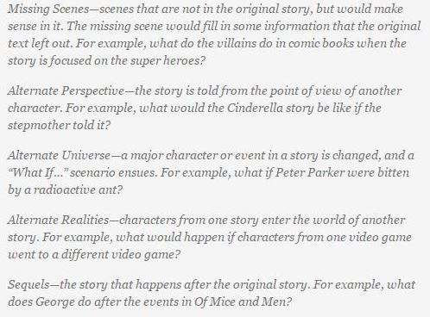
Let’s make some Fanfiction!
Pick a franchise or a character that you love and choose one of the below options:

Slide 12
Share.
Notes:
Instruct students to share with someone near them. Explain that they do not have to share all of the writing. They can choose parts to share.

Slide 13
Closure
Today you learned about fanfiction. How can fanfiction connect to your daily life? Will you write more fanfiction after today?

Slide 14
Thank you.

