Slide 1
Evolution of My Thinking
High School Writing Conference
December 8, 2017
Amanda Shoopman

Slide 2
Introductions
Your favorite type of writing
Your favorite book
Something interesting about yourself (hobbies, talents etc.)
Notes:
5-8 Minutes
Raise your hand. Once you find a partner put your hand down.
A little about me:
I first started actively writing when I was in middle school. I had just discovered the wonderful world of Harry Potter fanfiction, and I spent my nights reading and writing away. It paved the way toward my love of writing and my desire to continue growing.

Slide 3
Agenda
Focused Freewrite
Collaborate
Write Again
Share!!!

Slide 4
Goals
Today, we will be:
Looking at the way words change meaning over time.
Taking a word and breaking down its evolution into meaningful writing.

Slide 5
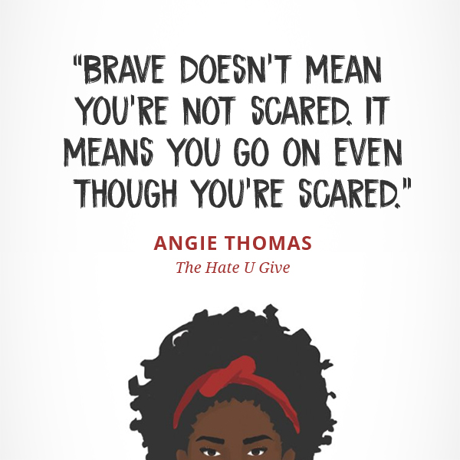
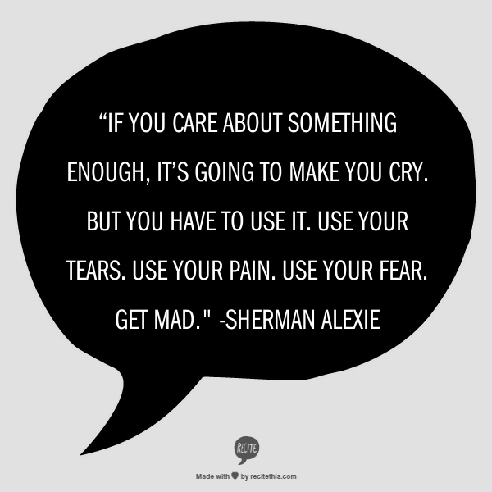
Freewriting
Notes:
15-18 Minutes
Read through these quotes. You can pick one to focus on, or use both of them as inspiration for your writing. I can only give you about 15 minutes to write. Think about any memories or feelings that these quotes elicit. What do they make you think about? Anything goes here. The only rule is that you have to keep writing until time is up.
(Other possible YA quotes to use)
“Sometimes you can do everything right and things will still go wrong. The key is to never stop doing right.” Angie Thomas, The Hate U Give
“Life is a constant struggle between being an individual and being a member of the community.” Sherman Alexie, The Absolutely True Diary of a Part-Time Indian
“Sometimes your world shakes so hard, it's difficult to imagine that everyone else isn't feeling it too.” Nicola Yoon, The Sun is Also a Star
“It's about the courage to go for what you want, not just what you think you need. Sometimes we don't even know what that is.” Sarah Dessen, Once and for All
“I was beginning to learn that your life is a story told about you, not one that you tell.” John Green, Turtles all the Way Down
There really are no rules as far as freewriting topics. The goal is to choose something that will get students writing about themselves. This can be a quote, picture, statement, or even a song. The only point here is to encourage thoughtful, personal writing.

Slide 6
Share!!!
Share your writing with your shoulder partner.
Thank them after they finish!
Notes:
5 Minutes
Read what you wrote to a partner. If you aren’t comfortable sharing the whole thing, feel free to pick out a sentence or phrase that you are particularly proud of.

Slide 7
Choosing a Word
Read over your writing
Underline one word that jumps out to you as important.
Notes:
8-10 Minutes
Now that you have had a second to look over your writing, I want you to pick 1 word that is the most meaningful to you. Underline that word.
Can I get a volunteer?
Now everyone is going to share their word. (Volunteer writes on the board.)
Look at these words, I want you to choose one word from this list. It can be the word that you came up with, or it can be someone else’s, but I want you to chose one word that means something to you.

Slide 8
Writing
What feelings or memories are associated with each age?
Notes:
15-20 Minutes
We are going to start off by writing about what this word meant to you when you were in Kindergarten. Take the next 3 or so minutes to write. Feelings, memories, examples?
Ok, now lets do the same thing for 5th grade.
Now, write about what this word means to you today.
What do you think this word will mean to you in 30 years?
Take a couple minutes to read over what you have written and give it some closure. What does it all mean? What ties this together? How has the theme changed?
****See final slide for Structure instructions*****

Slide 9
Share Again!
Share with a partner.
Any volunteers?
Notes:
5-10 Minutes
Partner shares- same rules as before.
I will share my writing.
Ask for volunteers to read. (Can be all or some)

Slide 10
Exit Slips
What did you learn from this lesson?
Do you think that you could use this format in the future? How?
Notes:
Only if there is enough time. (Have notecards for this)

Slide 12
Structure
Word:
When I was in Kindergarten: | When I was in 5th Grade:
Now: | In 30 years:
Tie it together
Notes:
Instructions:
Students will freewrite about a quote or truism that the teacher provides.
This prompt should be chosen to elicit some type of feeling from the student.
Students will pick a word from their writing that is particularly meaningful or important.
Class will share words, giving students the opportunity to change words.
Students will then write briefly about what the word meant to them in Kindergarten, 5th grade, now, and 30 years from now.
After, they will be given the opportunity to reflect on changes in theme, meaning, etc.
This will cause students to quickly produce the beginnings of a meaningful essay. The structure of the exercise leads students through a foolproof essay plan, while also ensuring that the final project will be different with each student. (It is the roadmap to a completed essay)
I choose to do this in a freewriting style. I have also seen this lesson done with worksheets, where students fill in the blanks (as on the slide above). I choose the freewriting strategy over the worksheet, because I feel like rambling for a couple minutes will cause the student to write something that they might not have if they just put a simple answer in a box. They may have more to pull from when transitioning this paper into a final draft.

